Slide 1
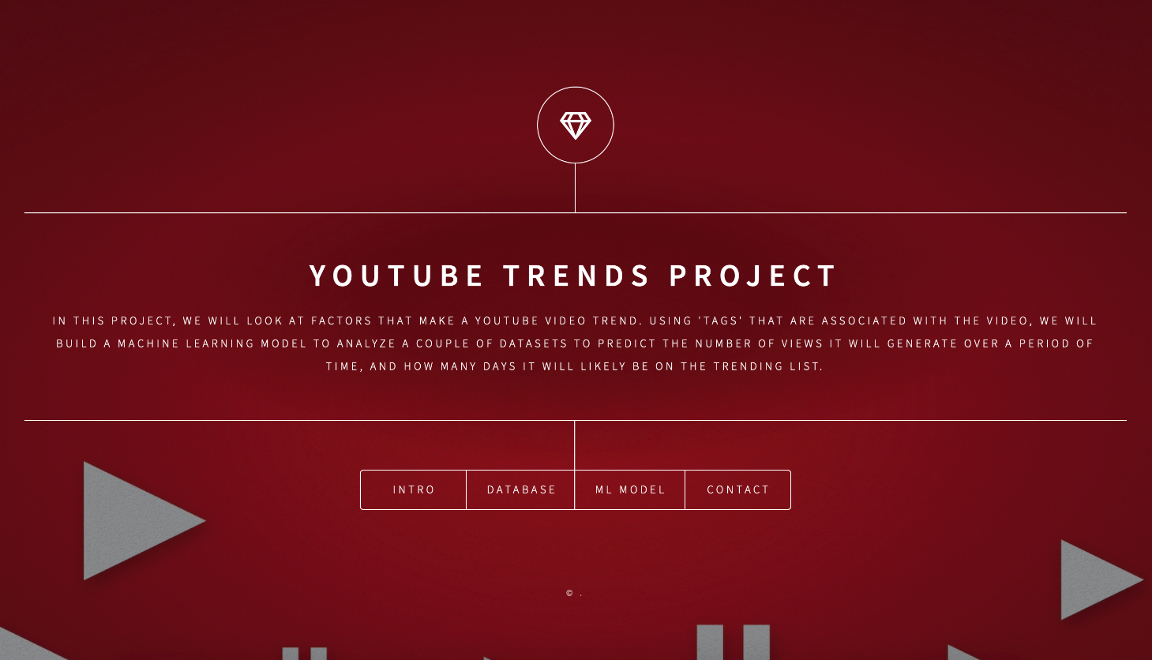

Slide 2
Team Members and Project Links:
Andy Feng
Syed Hossain
Harry Li
Michelle Huang
Link to Github Repository: https://github.com/afeng9889/YouTube_Trends_Project
Link to Dashboard: Dashboard Link

Slide 3
YouTube Trending Project
In this project, we will look at factors that make a Youtube video trend. Exploring the statistics of Trending YouTube videos to find what makes these videos so popular and analyze what are the main characteristics of the most popular videos on YouTube. Using 'tags' that are associated with the video, we will build a machine learning model to analyze a couple of datasets to predict the number of views it will generate over a period of time, and the category of video based on the specific tag words.

Slide 4
Why We Select YouTube Trending
YouTube is an app we consume everyday. YouTube has millions of videos uploaded everyday to their platform. Therefore, were interested to see what factors contributed to the success of a video. We currently believe that the more views, likes or followers the Youtubers get, higher the chances that their video will appear in the Trending page. We wanted to know which tags are the most successful in YouTube and identify that trend. Each Youtuber can influence the public through this media platform. For this we hope to understand what sort of content/category the prospective Youtuber should focus on to reach a high level of success.

Slide 5
Source of data
We used a dataset from Kaggle that contains statistics of some top trending YouTube videos from November 2017 to June 2018 in US. Here is the link to the dataset: Trending YouTube Video Statistics | Kaggle In order to make our analysis more accurate and relevant, we only focused on US videos, reducing the dataset’s size to 40k rows and 16 columns.

Slide 6
Questions we want to answer from our data
What are the top 100 ”Tags” ?
Based on the top 100 Tags, how many views will it generate?
What is the Category ID of the video Based on the video “Tag”?

Slide 7
Data Exploration Phase of the Project
We analyzed the dataset to see if-
The Dataset is clean enough to perform the analysis/ if not what transformations need to be done
The Size of our dataset, if we have enough data to predict and accurate outcome and feed it into our train/test data for our machine learning model.
Seeing if the dataset had features and target variables to help in answering our questions.

Slide 8
Description of Data Analysis Phase
The CSV was loaded into a Postgres SQL server and stored in 5 tables.
Data was connected to Pandas from Postgres SQL.
Un necessary columns that would serve no use case as features or targets were dropped in Pandas.
Our training and testing setup performed by categorizing number of views into groups (target variable: y) and the tag names as our independent variable (features: X).
Used random forest model to predict the trend. We will also use Naive Bayes to predict the category ID based on the tag.
Second machine learning model was created to find significant tags (p value < 0.05) to help predict view counts of videos.
Our logistic regression model predicted an accuracy rate of 0.87. We attempted a Random Forest Classifier model to predict as well, and received the same result of 0.87.

Slide 9
Technologies Used
Data Cleaning and Analysis Pandas will be used to clean the data and perform an exploratory analysis. Further analysis will be completed using Python. Database Storage Postgres SQL is the database we intend to use. Machine Learning SciKitLearn is the ML library we'll be using to create a classifier. Our training and testing setup is categorizing number of views into groups (target variable: y) and the tag names as our independent variable (features: X). We currently plan to use random forest model to predict the trend. We will also use Naive Bayes to predict the category ID based on the tag. Dashboard We currently plan to use html to create a dashboard in a web browser and Google slides to create the final presentation. .

Slide 10

Questions?

